Slide 1



PENETRATION TESTING ARCHITECTURE & ENUMERATION
Target Enumeration &
Scanning Techniques
A comprehensive analysis of TCP bounce proxying, active heuristic fingerprinting, zero-packet passive analysis, and structured reporting schemas.

Slide 2
Reconnaissance Agenda
Exploring the mechanics of bounce scans, service detection databases, OS classification models, and multi-format scanner data pipelines.

Slide 3

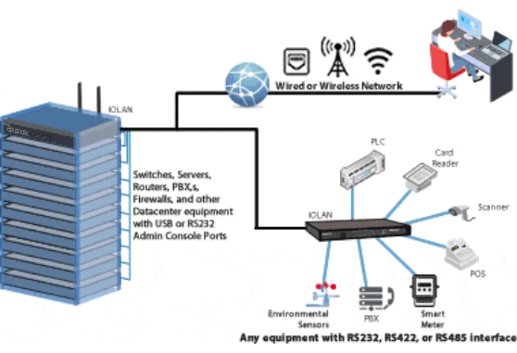
01. Reconnaissance Context
•
Target enumeration maps discovered responsive hosts to active software daemons and exact kernel releases.
•
Fingerprinting provides the intelligence required to locate corresponding exploits within CVE databases.
•
Stealth mechanics obscure scanner provenance and prevent early detection by enterprise intrusion systems.
•
Systematic logging enables machine-readable data ingest into automated vulnerability assessment frameworks.

Slide 4
02. TCP FTP Bounce Scan
RFC 959 Proxy Feature: Early FTP specifications allowed clients to establish proxy connections instructing a server to transfer files directly to third-party endpoints.
Origin Obfuscation: The attacker issues the FTP PORT command pointing to the target host and destination port, masking the actual scanning IP.
State Feedback Evaluation: If the target port is open, the FTP daemon responds with 226 Transfer complete; closed ports return transmission failure codes.
Modern Remediation: Modern FTP servers disable proxy bounce capabilities by blocking non-standard PORT declarations to mitigate misuse.

Slide 5


03. Service Version Detection
Probe Methodology (-sV)
Vulnerability Correlation
After discovering open ports, Nmap transmits specialized application-layer probes defined in the nmap-service-probes database.
The integrated database holds signatures for over 2,200 well-known service protocols across common TCP/UDP endpoints.
Responses are inspected for banners, application handshakes, and distinctive error string patterns to accurately pinpoint daemon names and versions.
Identifying the exact version (e.g., Apache 2.2.14 vs. 2.4.49) enables direct cross-referencing against public exploit repositories.

Slide 6
04. Active OS Fingerprinting
Heuristic Stack Analysis (-O)
2,600+
Nmap actively transmits crafted TCP, UDP, and ICMP probes to open and closed ports on the target machine.
It examines Initial Sequence Number (ISN) generation, TCP options order, IP ID sampling, and window sizes against internal reference templates.
Known OS Signatures

Slide 7


05. Passive OS Fingerprinting
Zero-Packet Emission
Operational Use Cases
Unlike active scanners, p0f transmits zero interrogation packets onto the wire, rendering it completely invisible to target intrusion detection systems.
Covert Reconnaissance: Assessing locked-down perimeter hosts where active scans trigger automatic firewall blocks.
Forensics & Monitoring: Uncovering rogue workstations, non-compliant operating systems, and unauthorized network routing devices.
It captures and evaluates legitimate packet streams, inspecting default Time to Live (TTL), window size, MTU, and DF (Don't Fragment) flags.

Slide 8
06. Detection Method Comparison
Evaluation Metric | Active Nmap Scanning (-O) | Passive Fingerprinting (p0f)
Traffic Generation | High: Sends multiple crafted TCP/UDP packets | Zero: Passively monitors existing wire traffic
IDS / IPS Noise | Loud: Rapidly detected and logged by security sensors | Undetectable: Generates zero target-bound packets
Host Prerequisites | Requires at least one open and one closed port | Requires active network traffic from the target
Classification Granularity | Highly granular release and patch-level matches | Broader OS family and kernel release estimates

Slide 9








07. Nmap Output Formats
Normal Format (-oN)
Grepable Format (-oG)
XML Format (-oX)
Human-readable plaintext output that mirrors terminal display. Best for immediate command-line verification and manual analyst review.
Restructures scan results into a concise one-host-per-line format. Specifically optimized for quick command-line filtering using grep, awk, and sed.
Structured schema format designed for programmatic ingestion into Metasploit, Armitage, Dradis, and custom reporting pipelines.

Slide 10
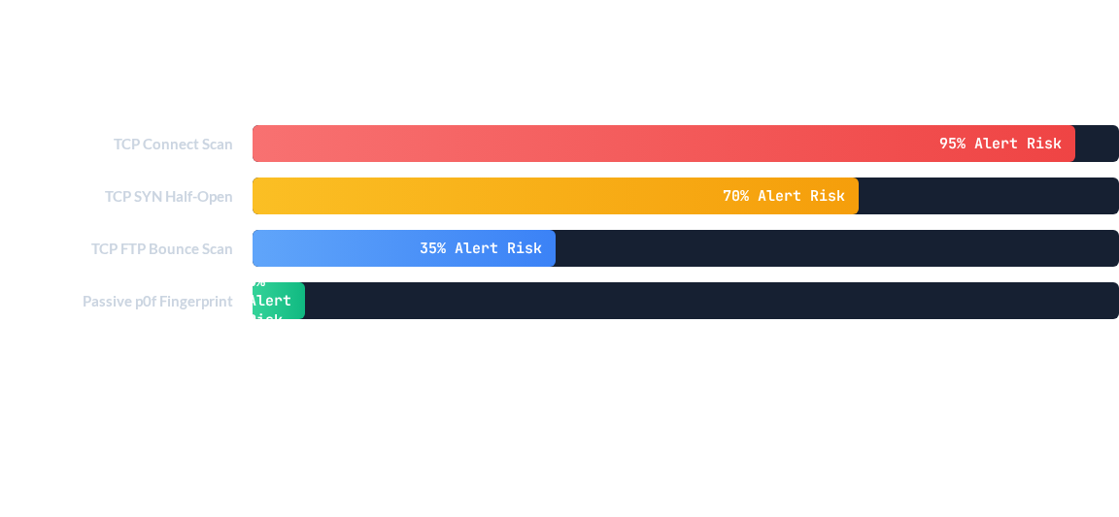
08. Scan Stealth & Noise Metrics
Direct active handshakes generate heavy logging traces on modern firewalls, while proxy bounce scans and passive fingerprinting dramatically decrease detection exposure.

Slide 11
09. Reconnaissance Workflow
2. Port Sweeps
4. Data Parsing
SYN and stealth scan modes determine open, closed, or filtered states.
Grepable and XML records export data directly into exploit frameworks.
1. Host Discovery
3. OS & Versions
ICMP echo and TCP ping sweeps map live targets across the subnet.
Active Nmap probes and passive p0f sniffing isolate daemon versions.

Slide 12
Questions & Review
Target Enumeration and Scanning Techniques (Baloch, pp. 109–113)
Rafay Baloch • Ethical Hacking & Penetration Testing Guide

Slide 13

Image Sources
https://www.perle.com/images/diagrams/terminal-server-diagram-md.gif
Source: www.perle.com

